Slide 1
Chapter 1
Overview of Marketing

Slide 2
Chapter 1: Overview of Marketing
LEARNING OBJECTIVES
LO1 Define the role of marketing and explain its core concepts
LO2 Describe how marketers create value for a product or service
LO3 Summarize the four orientations of marketing
LO4 Understand the importance of marketing both within and outside the firm

Slide 3
Group Discussion
Identify a high-value product made from the cheapest raw material
Identify consumers for thbe product and the potential buyers
Evaluate all the promotion campaigns of the company

Slide 4

Providing Value
Build & maintain a loyal customer base
Make a product that satisfies a variety of consumer demands
Consumer positioning is important
Good marketing can establish value
Leveraging influencers to help promote a brand is critical

Slide 5

What is marketing?
Marketing is a set of business practices designed to plan for and present an organization’s products or services in ways that build effective customer relationships.

Slide 6
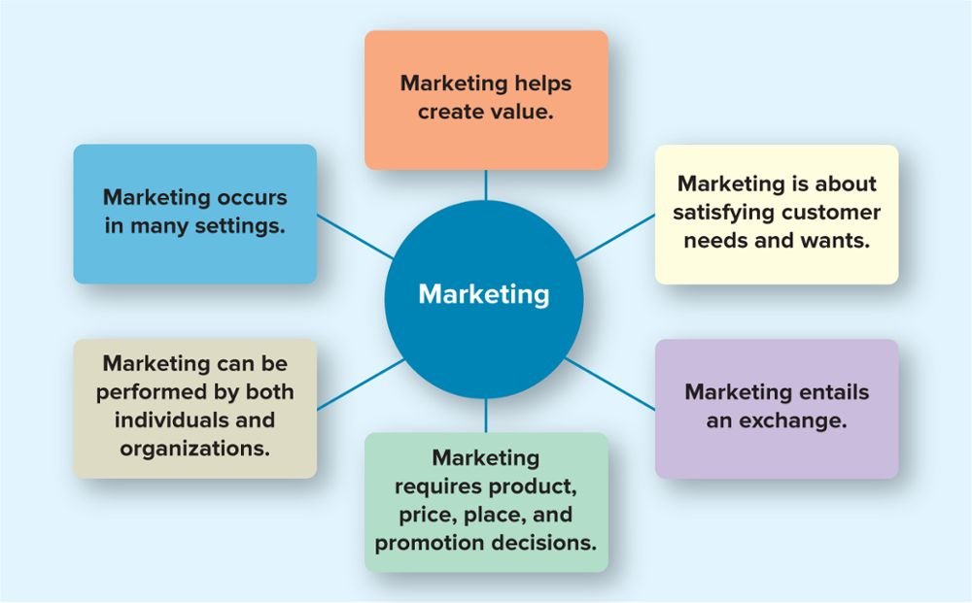
Core aspects of marketing
Notes:
.

Slide 7

Satisfying customer needs & wants
Need: basic necessities
Want: how to fulfill that need
Marketers must identify who will buy their products. Hydro Flask products are geared to people who want a sturdy, reusable bottle that keeps their water cold.

Slide 8

Satisfying customer needs & wants
Target Markets customer segment to whom the firm is interested in selling its products and services
What type of customer would buy a car valued at over $80,000?

Slide 9

Entails a marketing exchange
The exchange can occur
between any two parties
Not simply a buyer and
seller exchanging money
for a good or service
Can be an exchange of
information for
convenience
When you buy a Takeya Actives water bottle, you exchange the bottle for money and information about yourself.

Slide 10
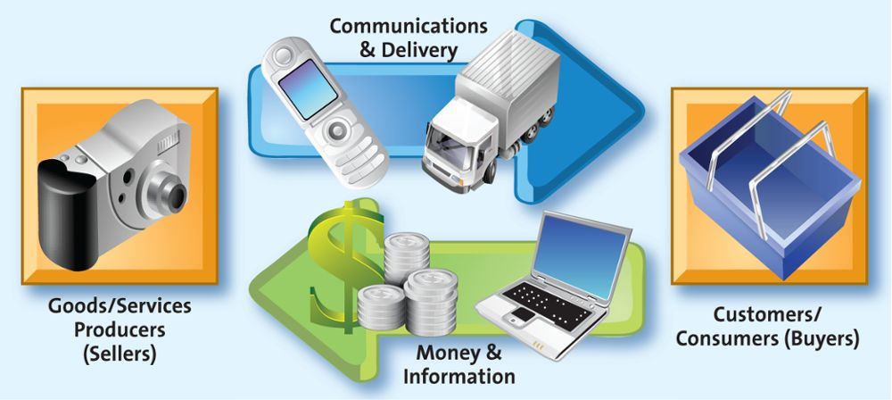
Marketing entails an exchange

Slide 11
Test Your Knowledge
Which of the following is NOT part of a marketing exchange?
A) Sellers provide products or services.
B) Sellers communicate and facilitate delivery.
C) Marketers assess the effectiveness of their
advertising.
D) Buyers complete the exchange by giving money
and information to the seller.

Slide 12
Test Your Knowledge
Which of the following is NOT part of a marketing exchange?
A) Sellers provide products or services.
B) Sellers communicate and facilitate delivery.
C) Marketers assess the effectiveness of their
advertising.
D) Buyers complete the exchange by giving money
and information to the seller.

Slide 13
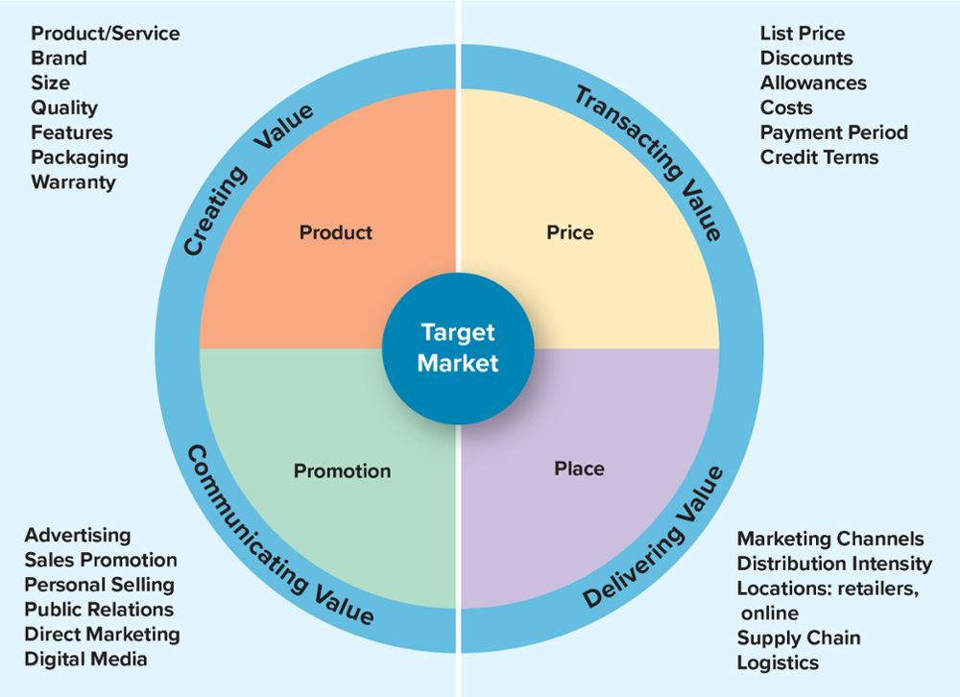
Marketing requires marketing mix decisions

Slide 14

Product: creating value
Goods
Services
Ideas
All watches are goods, and they tell the time. But Rolex is marketed as a status brand.

Slide 15
Price: transacting value
Price is everything the buyer gives up in exchange for the product.
money
energy
time

Slide 16
Place: delivering value
All activities necessary to get the product to the right customer when that customer wants it.
Supply chain management is the field that examines these activities.
Where would you find this product in the store?

Slide 17
Place: Marketing Channels
Distribution Strategy
How does a company get the product to the right customer when and where they want it?
Notes:
-

Slide 18

Promotion of ideas creates value
Ideas include thoughts, opinions, philosophies, and intellectual concepts that also can be marketed.
Marketing creates value by promoting ideas such as bicycle safety.

Slide 19
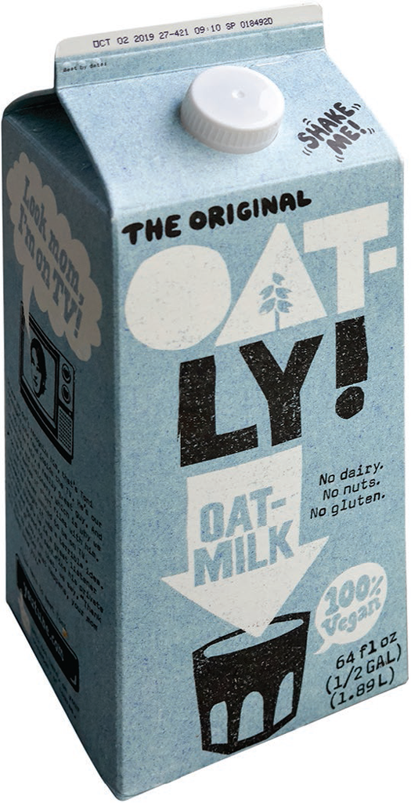
Promotion: communicating value
The communication activities of marketing
Used to inform, persuade and remind
potential buyers
Used to influence their opinions or elicit a
response
It isn’t easy to promote oat milk, so Oatly first promoted it to coffee shops and then designed a fun package to get attention in supermarkets.

Slide 20
Test Your Knowledge
Promotion is ____________ by a marketer that informs, persuades, and reminds potential buyers about a product or service to influence their opinions or elicit a response.
A) smoke-and-mirrors
B) coercion
C) teasing
D) communication

Slide 21
Test Your Knowledge
Promotion is ____________ by a marketer that informs, persuades, and reminds potential buyers about a product or service to influence their opinions or elicit a response.
A) smoke-and-mirrors
B) coercion
C) teasing
D) communication

Slide 22
Marketing can be performed by both individuals & organizations
B2B: Wholesaling is often only Business to Business
B2C: All retailing is Business to Consumer selling
C2C: Swap Meets,
EBay, yard sales, etc.

Slide 23
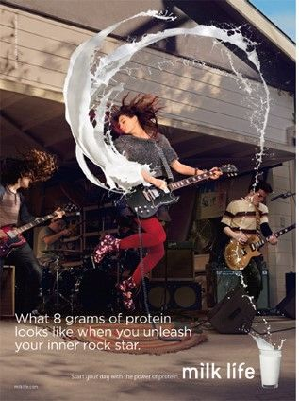
Marketing impacts many stakeholders
Both profit and non-profit entities
Developing economies
Entire industries
“Milk Life” replaced the well-known “Got Milk?” campaign, but the ads still create a high level of awareness for the milk industry.

Slide 24
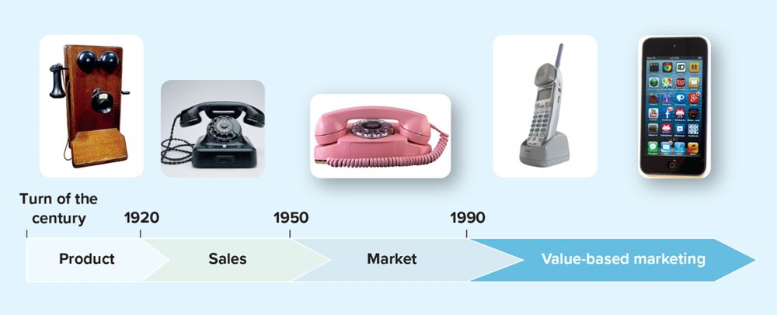
The four orientations of marketing
Product Orientation
Market Orientation
Sales Orientation
Value-based Orientation
Notes:
-

Slide 25
Product orientation
Product-oriented companies focus on developing and distributing innovative products with little concern about whether the products best satisfy customers’ needs.

Slide 26
Sales orientation
View marketing as a selling function where companies try to sell as many of their products as possible rather than focus on making products consumers really want.

Slide 27
Market orientation
Market-oriented companies start out by focusing on what consumers want and need before they design, make, or attempt to sell their products and services.

Slide 28
Value-based orientation
To compete successfully, firms focus on the triple bottom line:
People (consumer needs & wants)
Profits (long-term profitable relationships)
Planet (social and environmental responsibility)

Slide 29
Test Your Knowledge
What must firms do to become value driven?
A) Share information, balance benefits and costs,
and build customer relationships.
B) Set low prices, put profit above service, and use
effective marketing strategies.
C) Make logistics a priority, expand globally, and
always offer new goods and services.
D) Keep a vigilant eye on the market-place,
undercut competitors, and provide competitive
salaries.

Slide 30
Test Your Knowledge
What must firms do to become value driven?
A) Share information, balance benefits and costs,
and build customer relationships.
B) Set low prices, put profit above service, and use
effective marketing strategies.
C) Make logistics a priority, expand globally, and
always offer new goods and services.
D) Keep a vigilant eye on the market-place,
undercut competitors, and provide competitive
salaries.

Slide 31
How do firms become more value driven?
Firms focus on four activities:
Sharing information
Balance customer’s benefits & costs
Build relationships with customers
Use technology to connect with customers
Sharing Information
Balancing benefits with costs
Building customer relationships
Connecting with customers via social media

Slide 32

Sharing information
Why is sharing and coordinating information such a critical success factor for any firm?
Fashion designers for Zara, the Spain-based fashion retailer, collect purchase information and research customer trends to determine what their customers will want to wear in the next few weeks. They share this information with other departments to forecast sales and coordinate deliveries.

Slide 33
Case in point: Zara
How does the flagship brand of Europe’s fastest growing apparel retailer keep up with the latest trends?
Challenge
Answer
Results
By implementing sophisticated information technology into its customer tracking and supply chain functions.
Zara now has over 1500 women’s
clothing stores in 78 countries.
Products move from design
through the supply chain and onto
the stores shelves in about two
weeks.

Slide 34
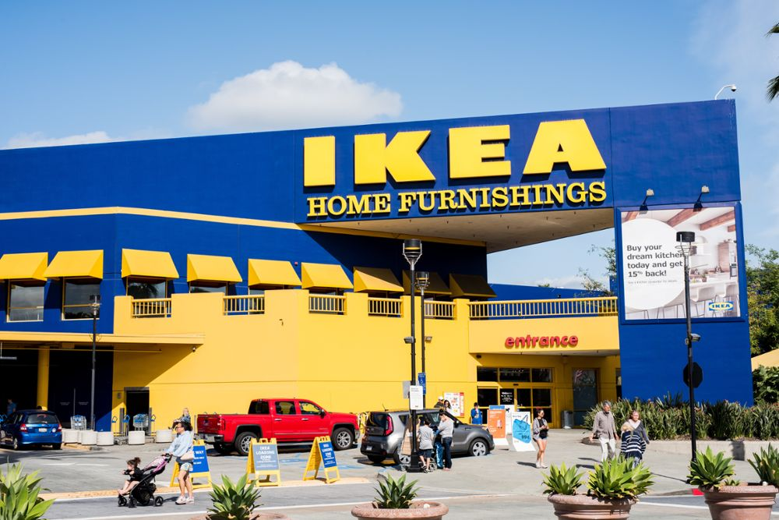
Balancing benefits with costs
Understand key benefits.
Focus on key benefits.
Eliminate cost of less strategic benefits.
Furniture retailer IKEA focuses on what its customers value—low prices and great design.

Slide 35

Building customer relationships
Take a long term view of customer relationships
Use data to assist in maintaining the relationship
To help meet its sustainability commitments, Starbucks developed a lid that takes the place of a straw.

Slide 36
Connect with customers using social media
Embrace social media to connect better with customers
91% of North American companies now use social media for marketing purposes
Users are driving the way brands & stores are interacting with social media

Slide 37
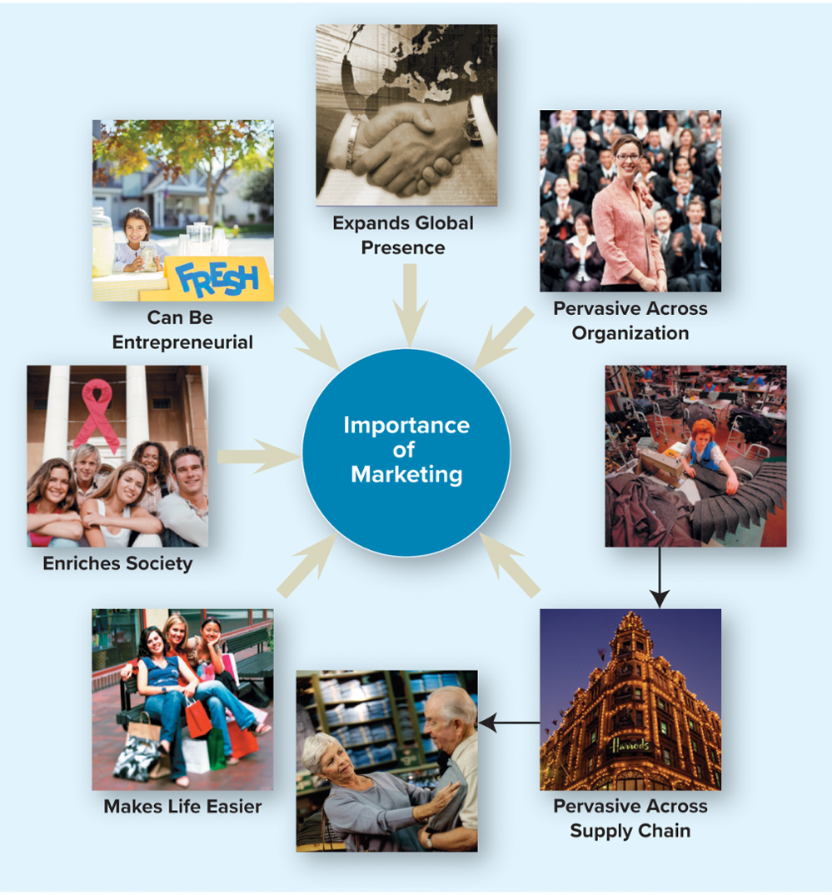
Why is marketing important?

Slide 38
Marketing expands firms’ global presence
Good are available to consumers from many countries from the far reaches of the globe
Must understand customers needs & wants
Segment-by-segment, region-by-region

Slide 39
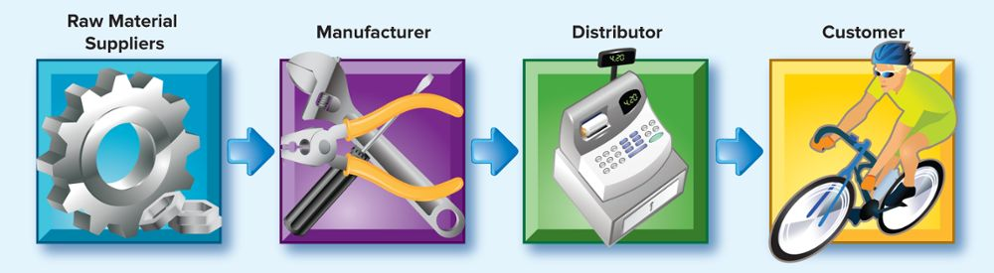
Marketing is pervasive across channel members
Each step in the supply chain involves marketing
All members in the chain must ultimately focus on creating value for their customer and the end user consumer

Slide 40
Test Your Knowledge
    Which of the following would NOT be considered part of a supply chain?
A) consumer
B) retailer
C) manufacturer
D) customer service representative

Slide 41
Test Your Knowledge
    Which of the following would NOT be considered part of a supply chain?
A) consumer
B) retailer
C) manufacturer
D) customer service representative

Slide 42
Marketing Enriches society
Canadian companies recognize that a strong social orientation is in both their and their customers’ best interests. It shows the consumer that the firm can be trusted with their business.

Slide 43


Marketing can be entrepreneurial
Though important to large firms, marketing is equally important to the success of small ventures—especially new ventures.
Dani Reiss has grown Canada Goose into a premium outerwear company sold around the world.
Tonia Jahshan successfully parlayed her love of tea from a small business into a global empire worth more than $20 million.

